Slide 1
Time-resolved NMR monitoring
of tRNA maturation

Slide 2
RNA modifications

Slide 5
tRNA-Tyr single letter code modifications (17)

Slide 6
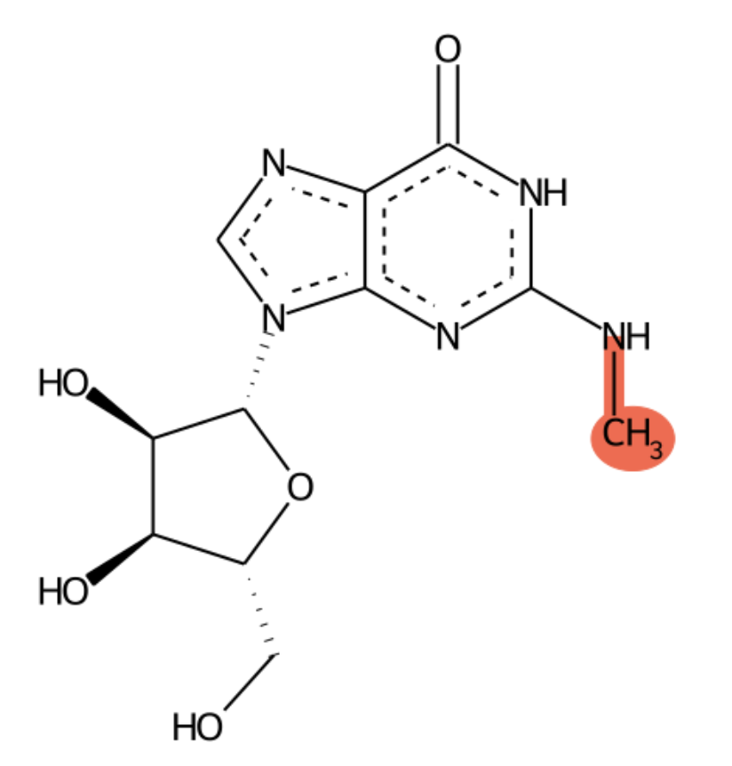
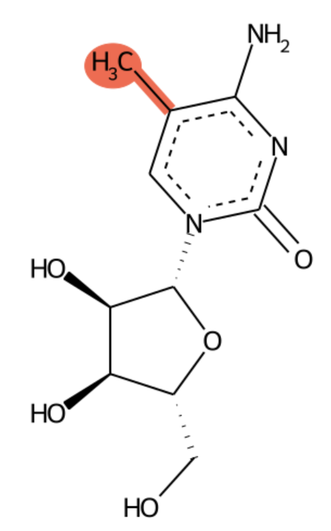
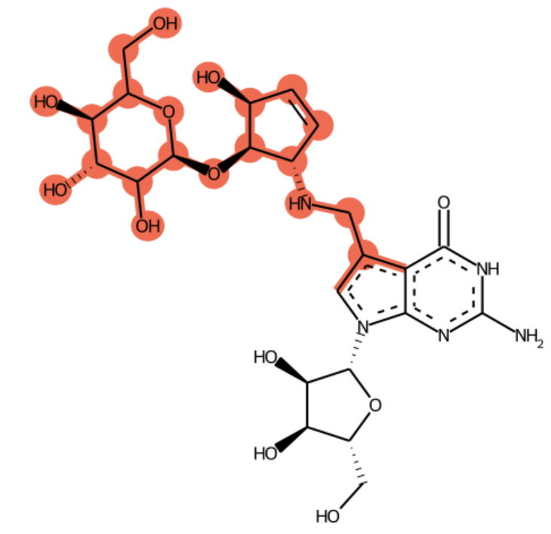
L (m2G)
? (m5C)
9 (galQ)

Slide 7
? (m5C)
L (m2G)

Slide 8
pAr(p) pGr(p) Ar(p) Gr(p) pm1Am pm1Gm pm1Im m1Im m1Am m1Gm pm2,2Gm m2,2Gm pm2Gm ps2Um pm2,7Gm pm2,7Gm m2,7Gm m2Gm s2Um pm3Um m3Um pac4Cm ac4Cm pm4,4Cm m4,4Cm pm4Cm m4Cm pmcmo5Um mcmo5Um phm5Cm pcmnm5Um hm5Cm cmnm5Um pmcm5Um mcm5Um pmchm5Um mchm5Um pncm5Um ncm5Um pAm pCm pGm pUm pm5Cm pm5Um pinm5Um inm5Um m5Cm m5Um pm6Am pm6,6Am m6,6Am

Slide 9
m6Am pf5Cm f5Cm pIm pYm Im Ym Am Cm Gm Um Xm preQ0base Qbase ppreQ0 preQ0 preQ1base ppreQ1 preQ1 poQ oQ pG+ G+ pgalQ galQ pQ pgluQ gluQ pmanQ manQ Q pm1acp3Y pm1acp3Y m1acp3Y pm1A pm1G mpN mpppN pm1I pm1Y m1I m1Y m1A m1G pnm5se2U nm5se2U pmnm5se2U mnm5se2U pcmnm5se2U cmnm5se2U pC+ pse2U C+ se2U pmsms2i6A msms2i6A pnm5ges2U nm5ges2U pmnm5ges2U mnm5ges2U pcmnm5ges2U cmnm5ges2U pk2C pges2U pms2io6A ms2io6A pms2i6A ms2i6A pms2t6A ms2t6A

Slide 10
pms2hn6A ms2hn6A pms2ct6A ms2ct6A pht6A ht6A k2C ges2U pm2,2G pm2,2,7G m2,2,7GpppN m2,2,7G m2,2G pnm5s2U nm5s2U pmnm5s2U mnm5s2U pcmnm5s2U cmnm5s2U pmcm5s2U mcm5s2U pncm5s2U ncm5s2U pcm5s2U cm5s2U ptm5s2U tm5s2U pm2A ps2C pm2G mmpN ps2U pm5s2U NADpN pinm5s2U inm5s2U m5s2U pm2,7G m2,7GpppN m2,7G pm2,8A m2,8A m2A s2C m2G s2U pacp3U pacp3D acp3D acp3Y acp3U pAp pGp pU2'3'cp pA2'3'cp pC2'3'cp pG2'3'cp N2'3'cp pmimG mimG pimG pOHyWx OHyWx pyW-72 yW-72 pOHyWy OHyWy pOHyW OHyW pyW o2yW pyW yW pyW-58 yW-58 imG pm3C pm3U pm3Y m3Y

Slide 11
m3C m3U acCoApN pac4C pimG2 malonyl-CoApN ac4C imG2 succinyl-CoApN pm4,4C m4,4C pm4C pimG-14 ApppN AppppN ApppppN CoApN pyW-86 yW-86 m4C imG-14 pmo5U mo5U pcmo5U cmo5U pmcmo5U mcmo5U pho5C pho5U ho5C ho5U pnm5U nm5U pmnm5U mnm5U phm5C pcmnm5U hm5C cmnm5U pchm5U chm5U pmcm5U mcm5U pmchm5U mchm5U pcm5U cm5U pnchm5U nchm5U pncm5U ncm5U ptm5U tm5U 5'-OH-N pA pC pG pG(pN) pN pU ppG ppN pppA pppG pppN pm5C pm5U pcnm5U cnm5U pinm5U inm5U pm5D m5D m5C m5U pio6A io6A pi6A i6A pms2m6A ms2m6A pt6A t6A phn6A hn6A pac6A m6ApppN m6AppppN m6ApppppN ac6A pm6A pg6A g6A pm6t6A m6t6A pm6,6A m6,6A pf6A f6A phm6A hm6A pct6A ct6A m6A pf5C f5C ps4U s4U pm7G m7GpppN m7GppppN m7G pm8A pD m8A D pI pY GpppN I Y xA xC xG xU A C G N U xX
334 mods

Slide 12
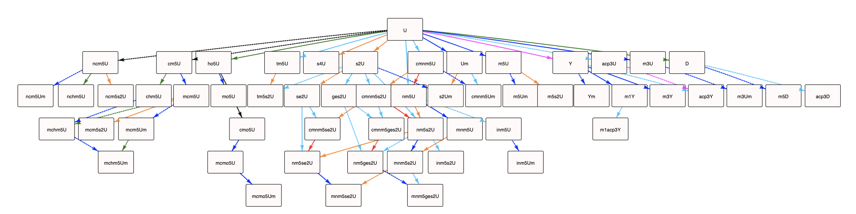

Slide 13
Do you remember how NMR works???

Slide 14
Like explaining how magnets work

Slide 15
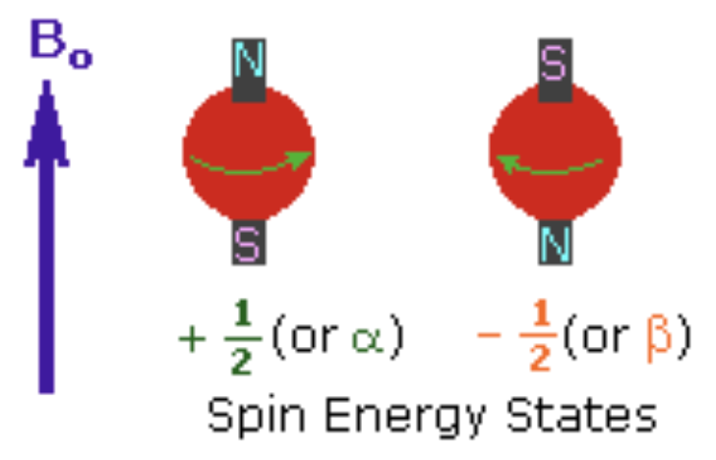
H, 13C, 15N isotopes have fractional spin of 1/2 optimal for NMR

Slide 16
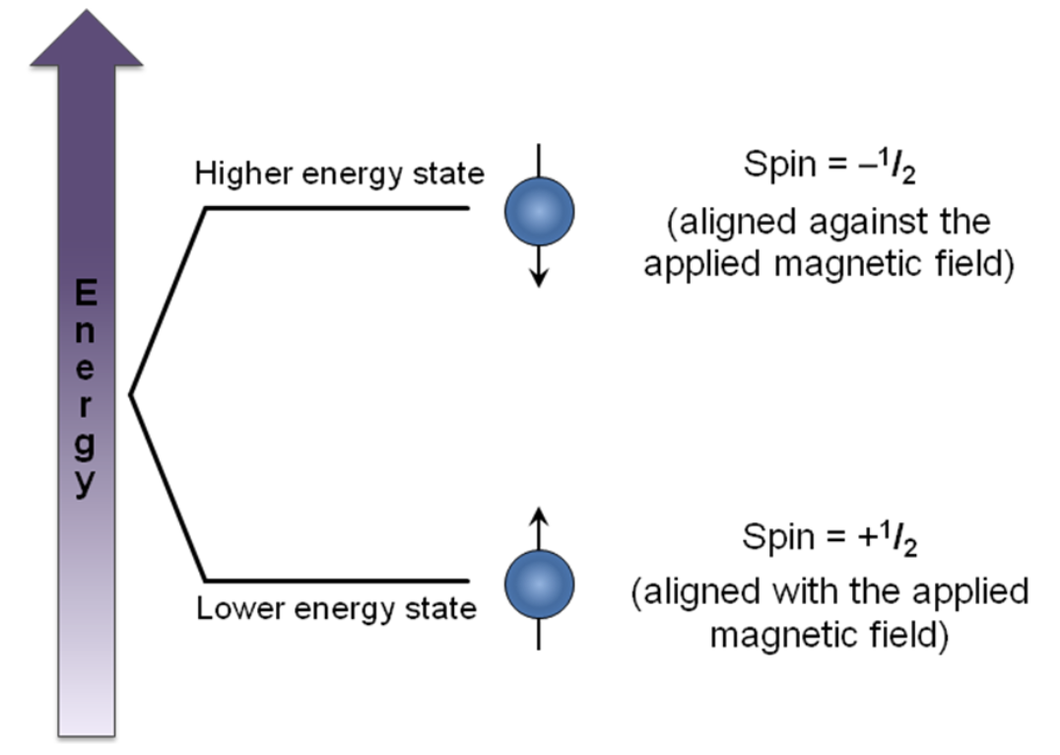

Slide 18
NMR measures magnetic shielding

Slide 19
Measuring tRNA modifications
with NMR

Slide 20
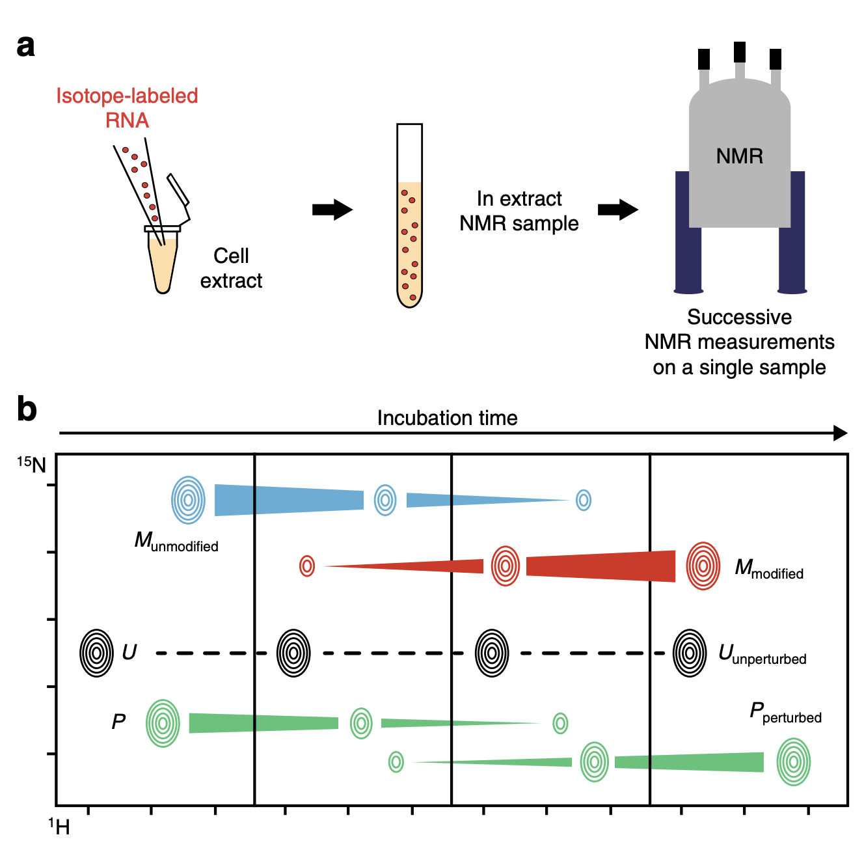

Slide 21
Only measuring U/G modifications directly,
A/C modifications are measured indirectly

Slide 25
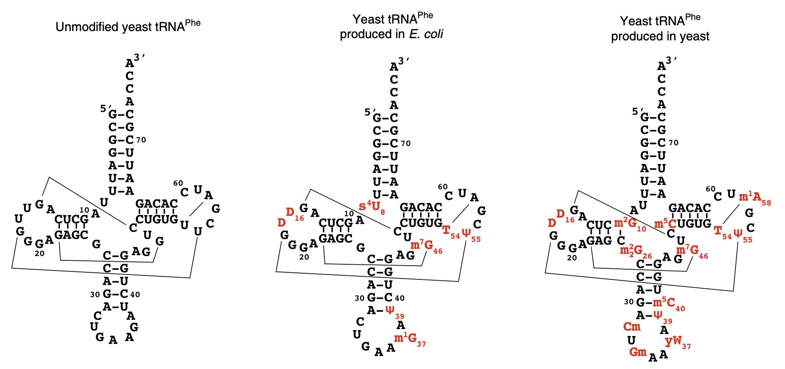

Slide 26
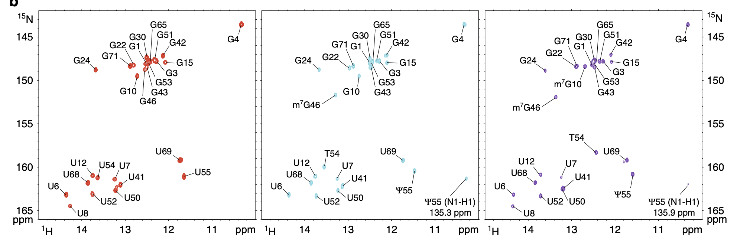
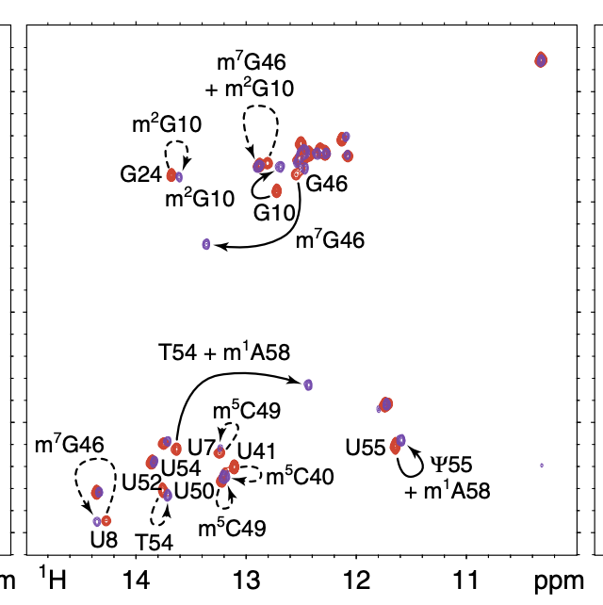
Mapping the tRNA-Phe
modifications

Slide 27
G46 methylation direct/indirect effect

Slide 28
Indirect effects are hard to understand
just looking at the cloverleaf structure

Slide 29
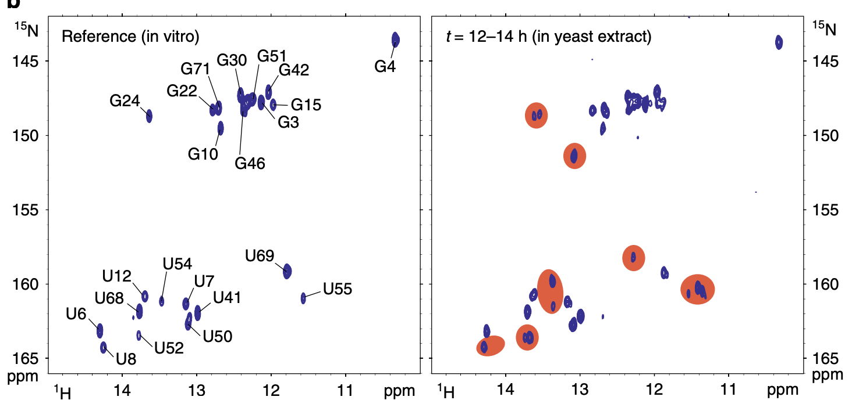

Slide 30
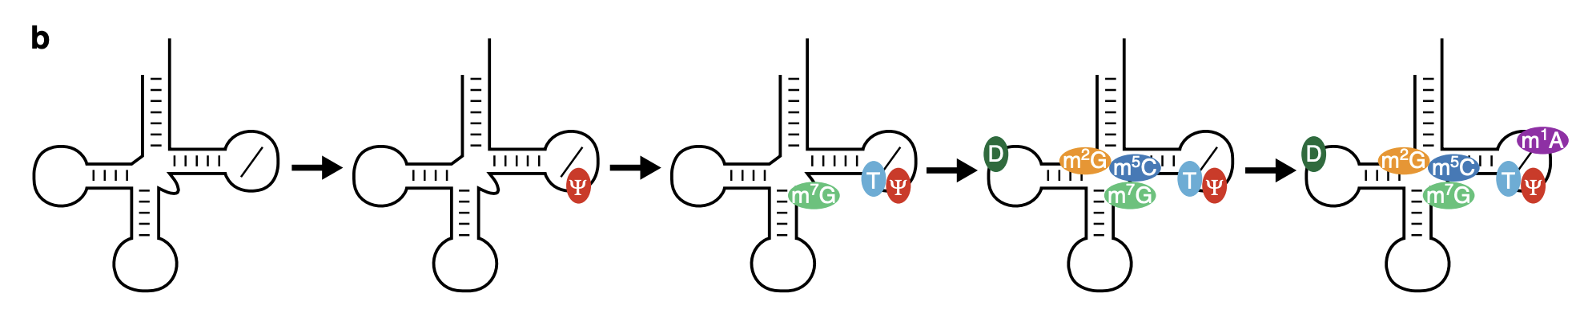
T54, Ψ55, and D16 are found in almost all yeast tRNAs
Ψ55 is added rapidly, before other mods

Slide 31
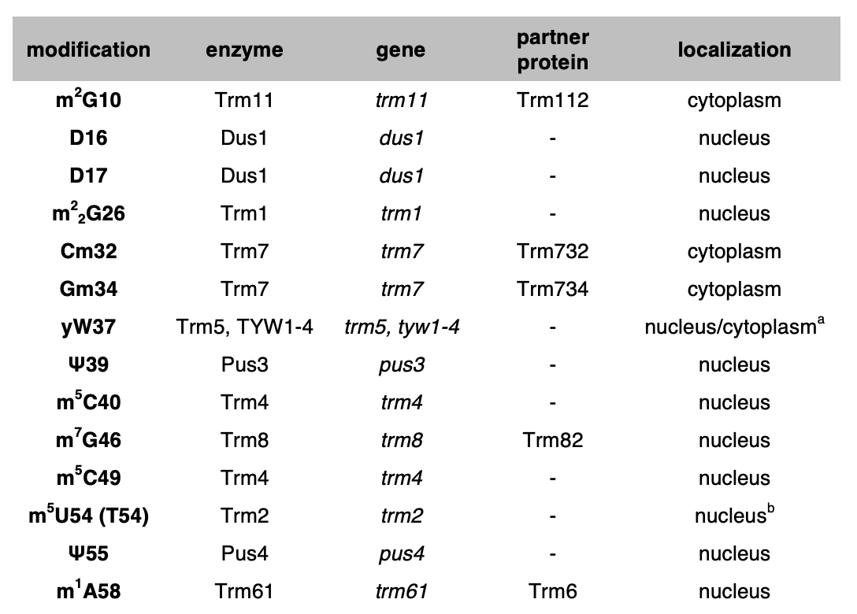

Slide 32
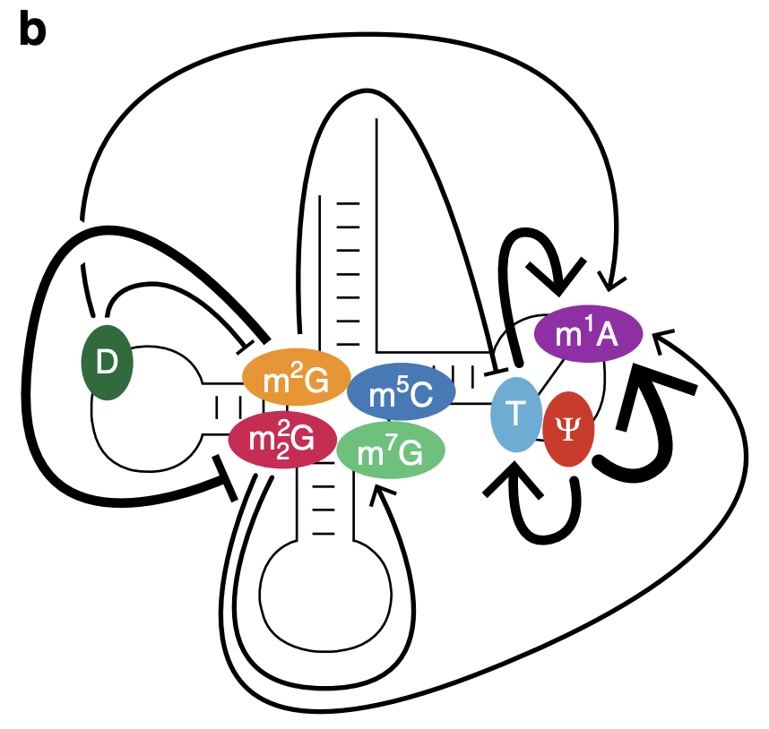
m2G is cyto
Compartmentalization
m2,2G is nuc
Ψ55 (pseudouridine) is an important initiator

Slide 33
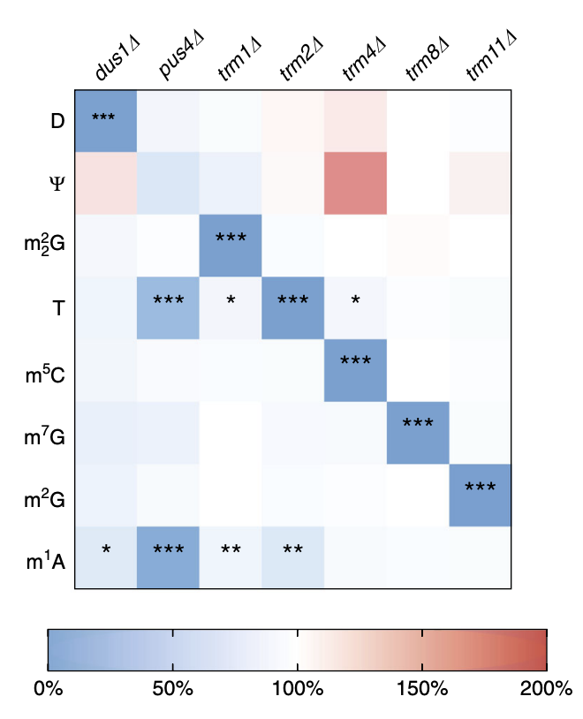
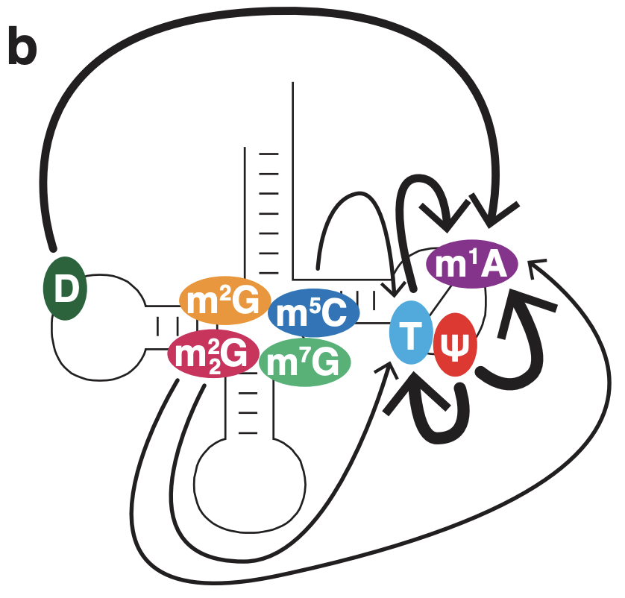
LCMS modification quant

Slide 34
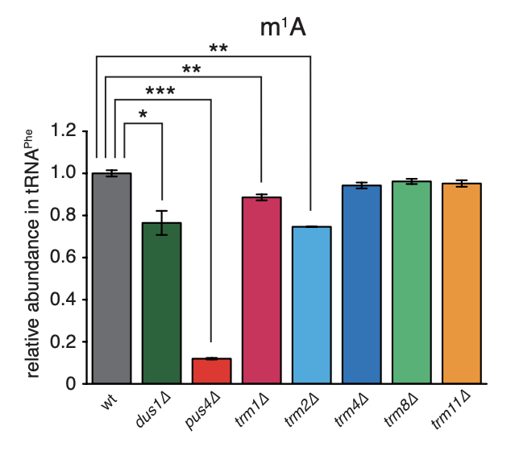
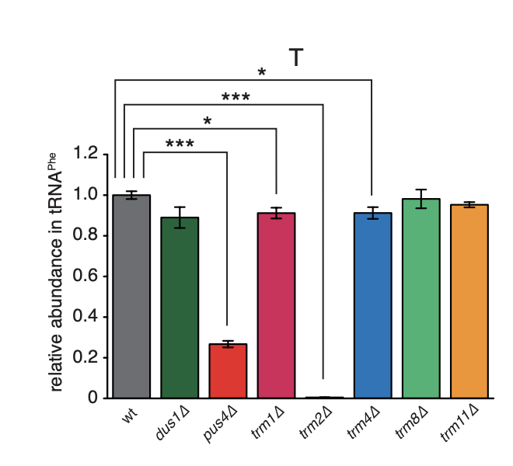
D16
Ψ55
T54
D16
Ψ55
T54

Slide 35
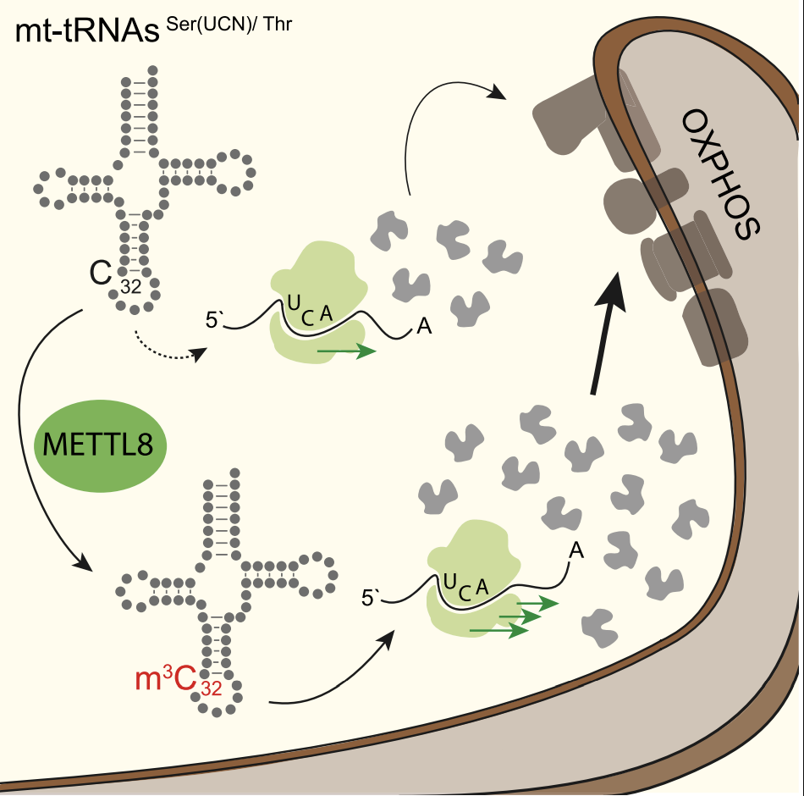
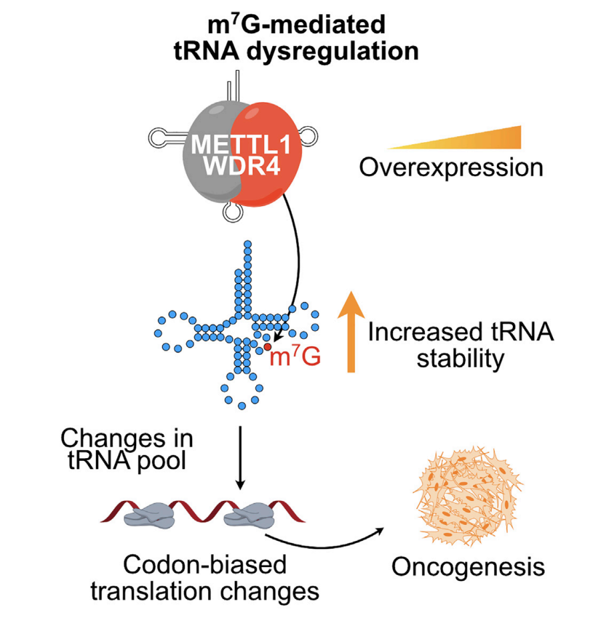

Slide 39
Detecting RNA modifications

Slide 40
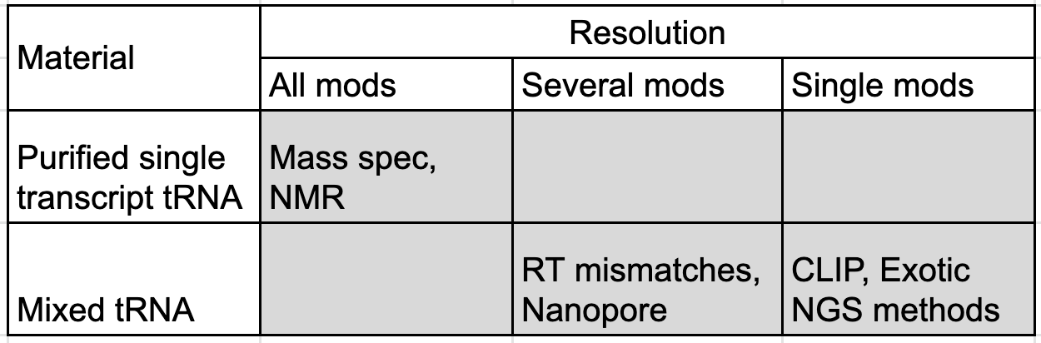
Requires single tRNA purification
Mass spec.
Antibody binding (CLIP)
NMR
RT mismatches
Exotic NGS methods
NanoPore

